Slide 1
Class and Sequence Diagrams for Yuppie City Simulator
Meandering Armadillos:
Nick Montiqulia, Michael Nishida, Andrew Ricci

Slide 2
Class Diagrams

Slide 3
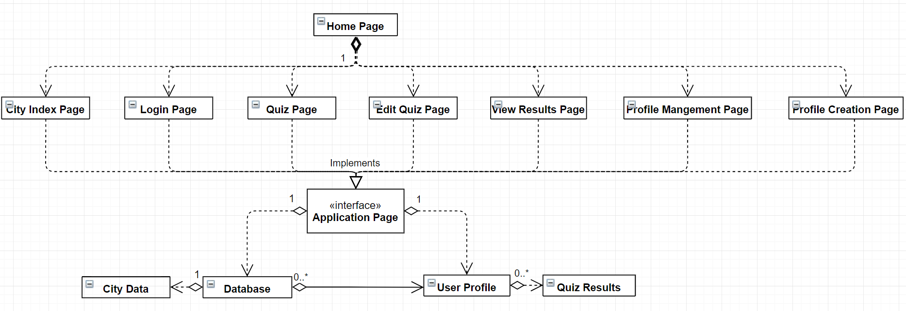
Minimal Overview

Slide 4
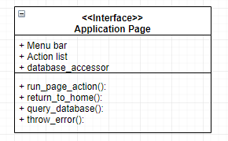
General Application Page (interface)

Slide 5
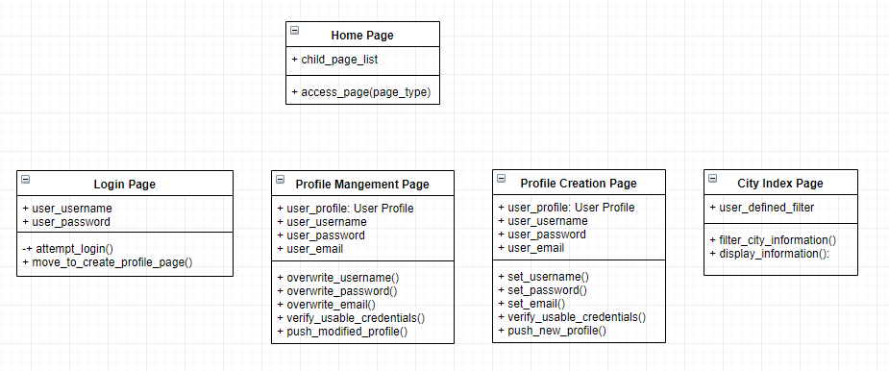
Application Page Implementations (part 1)

Slide 6
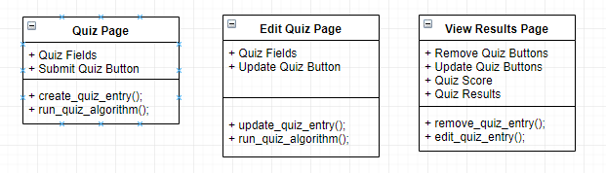
Application Page Implementations (Part 2)

Slide 7
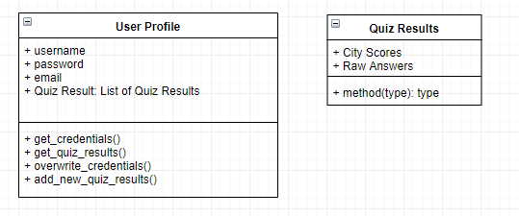
User Profile - Related Classes

Slide 8
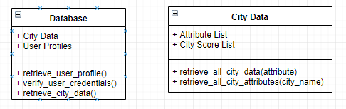
Database Classes

Slide 9
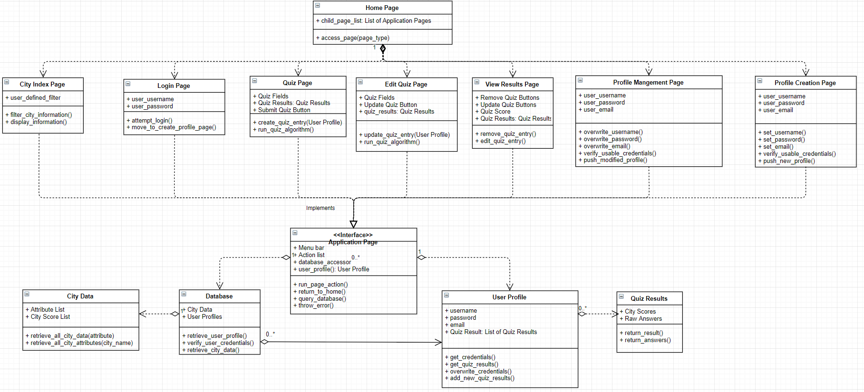
Detailed Overview

Slide 10
Sequence Diagrams

Slide 11
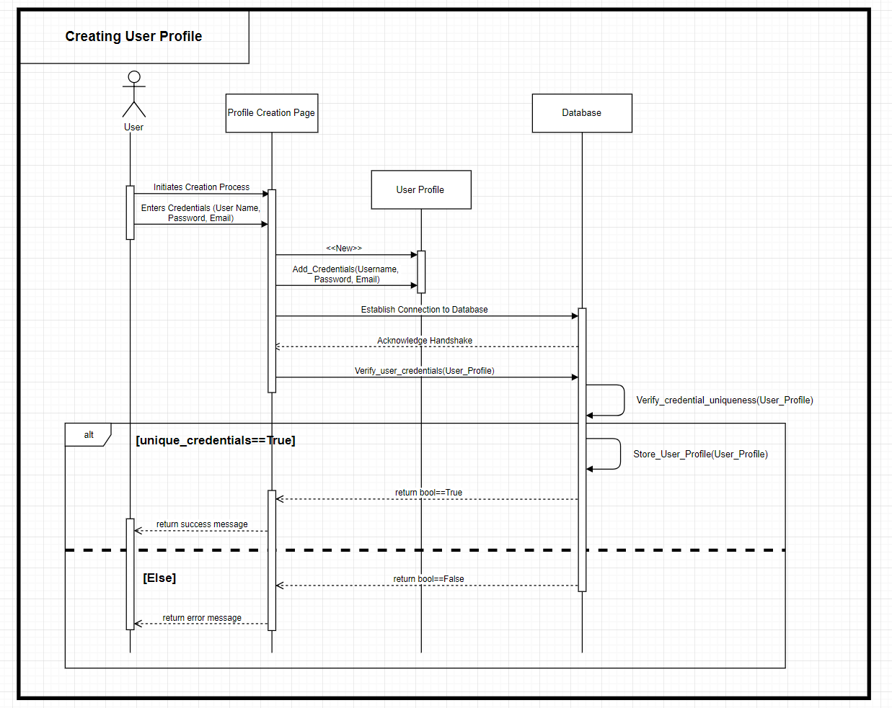
User Profile Creation

Slide 12
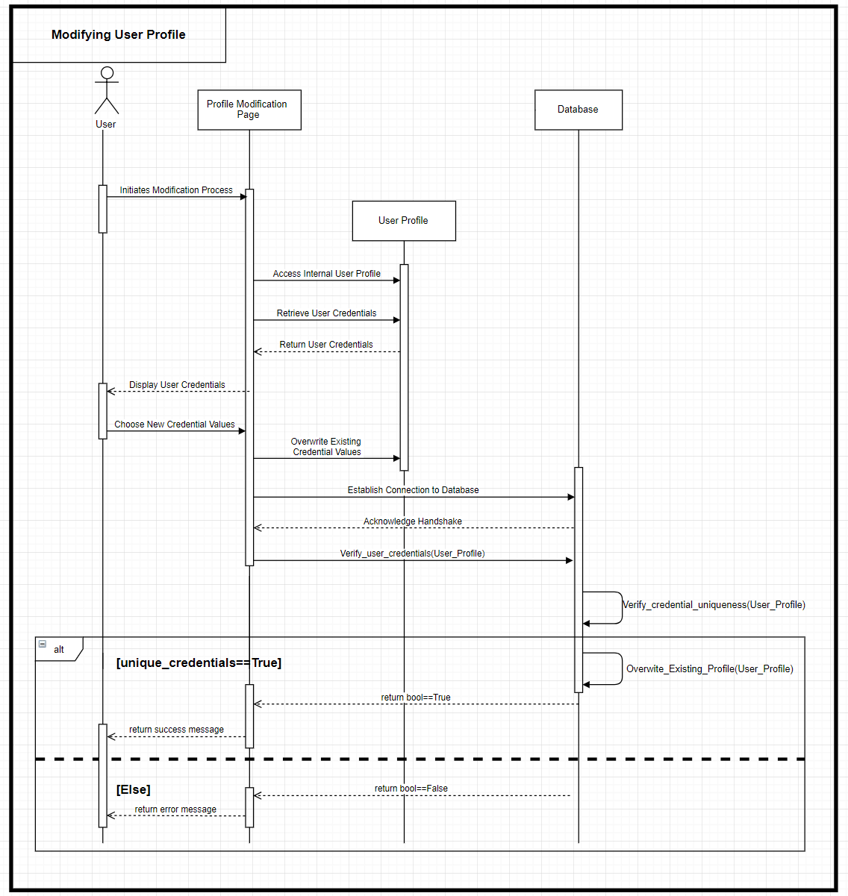
User Profile Modification

Slide 13
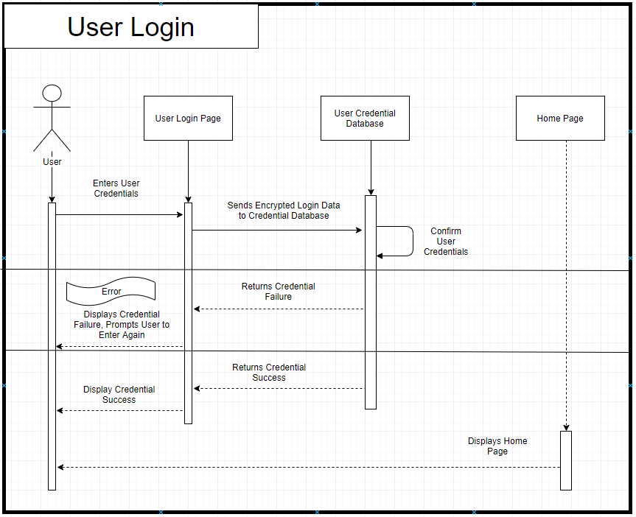
User Login

Slide 14
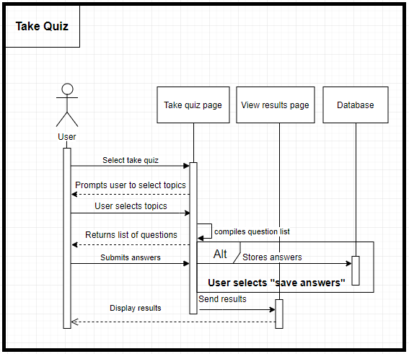
Take Quiz

Slide 15
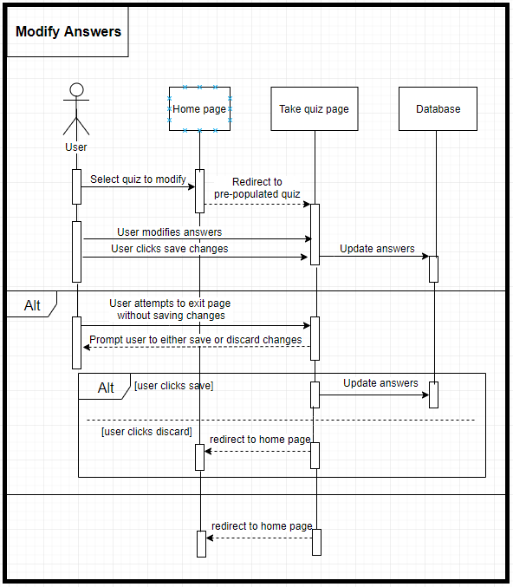
Modify Quiz Answers

Slide 16
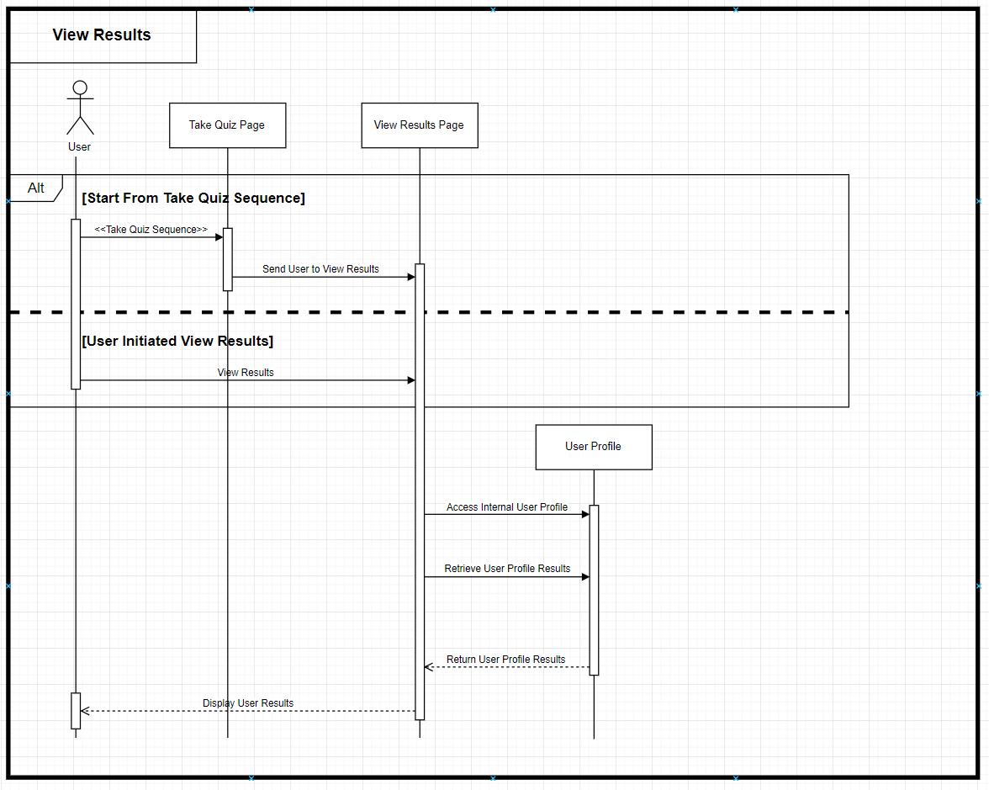
View Quiz Results

Slide 17
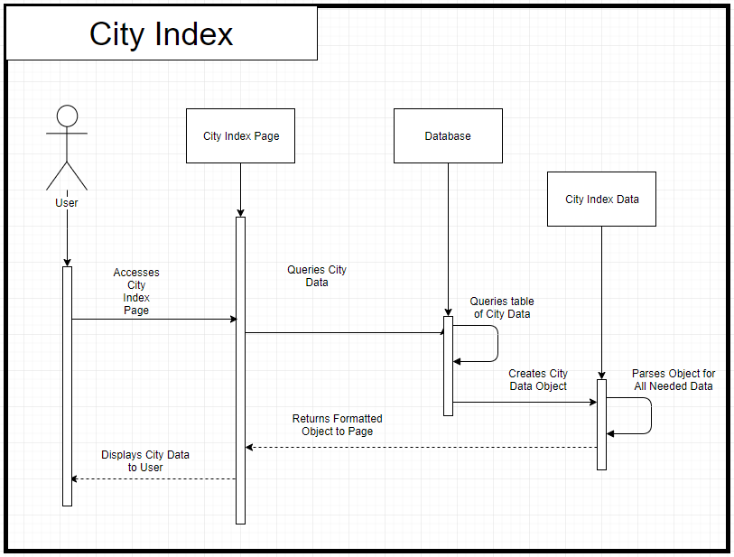
View City
Index

